Slide 1

Spring Boot Matthias Brun

Slide 2


Slide 3


Slide 4

SPA
REST Service
DB
?

Slide 5


Slide 6

Spring Boot makes it easy to create stand-alone, production-grade Spring based Applications that you can “just run”. Spring Boot Reference Guide

Slide 7

Inhalt
Einführung
Hello World
Starter Dependencies
Why Spring Boot?

Slide 8
Spring Boot
Spring Projekt (Version 1.0, April 2014)
Ziele des Projekts:
Provide a radically faster and widely accessible getting started experience for all Spring development.
Be opinionated out of the box, but get out of the way quickly as requirements start to diverge from the defaults.
Provide a range of non-functional features that are common to large classes of projects
Absolutely no code generation and no requirement for XML configuration.
Notes:
Pivotal, Cloud Foundry, EMC -> Dell Convention over Configuration

Slide 9
Hello World

Slide 10
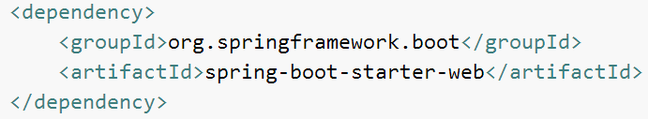
Starter Dependencies
spring-boot-starter-actuator
spring-boot-starter-batch
spring-boot-starter-data-jpa
spring-boot-starter-data-mongodb
spring-boot-starter-security
spring-boot-starter-web
….

Slide 11
REST Service und DB in der Cloud in 20 min

Slide 12

REST Service
Ticketsystem
Ticket (ID, Priority, Date, Reporter, Description)
GET /tickets
POST /tickets

Slide 13
Spring Data
Einfacher Zugriff auf Relationale und NoSQL DB
Spring Data JPA
JPA Repositories
Generiert und Validiert Queries beim Start
Method Name, Named Queries, @Query
interface TicketRepository extends JpaRepository<Ticket, Integer> {
List<Ticket> findByReporter(String reporter);
}
select t from Ticket t where t.reporter = ?1
Notes:
Kein Boilerplate Code

Slide 14
Spring Data - Method Name
findByProperty
findBy
Keywords
Examples
interface TicketRepository extends JpaRepository<Ticket, Integer> {
List<Ticket> findByReporter(String reporter);
}
select t from Ticket t where t.reporter = ?1

Slide 15
Spring Data - @Query
findByProperty[]
findBy
Keywords
Examples
interface TicketRepository extends JpaRepository<Ticket, Integer> {
List<Ticket> findByReporter(String reporter);
}
select t from Ticket t where t.reporter = ?1

Slide 16
Konfiguration
Property File (application.properties)
Command Line
Java
server.port=8888
java –jar target/ticket-0.0.1-SNAPSHOT.jar --server.port=8888
@Component
public class MyBean {
@Value("${server.port}")
private int port;
}
Notes:
Standard Properties sind Dokumentiert Link:

Slide 17
Why Spring Boot?
Simplicity
Speed (Bootstrapping und Entwicklung)
Self-contained, Portable
Continuous Delivery
PaaS
Spring Ökosystem
Notes:
Microservices Architektur Stiel Software in einzelne individuell deployable Services zerlegt, REST, JSON
Mittlerweile gibt es viele Alternativen (Dropwizard, Wildfly Storm, viele kleine Microframeworks)

Slide 18
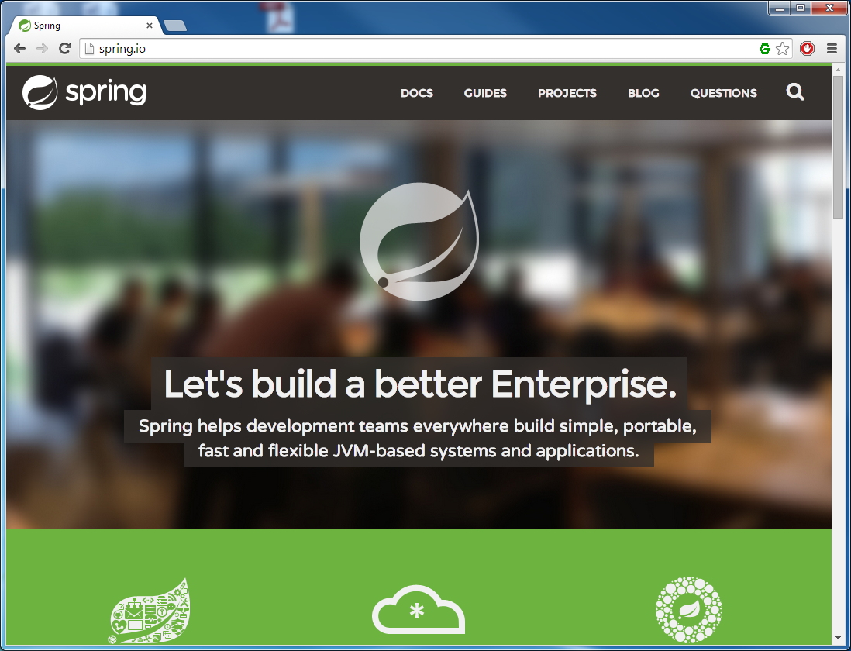
Links
http://projects.spring.io/spring-boot/
http://start.spring.io/
Notes:
Website verwendet Spring Boot!

Slide 19
Fragen
?

